Slide 1

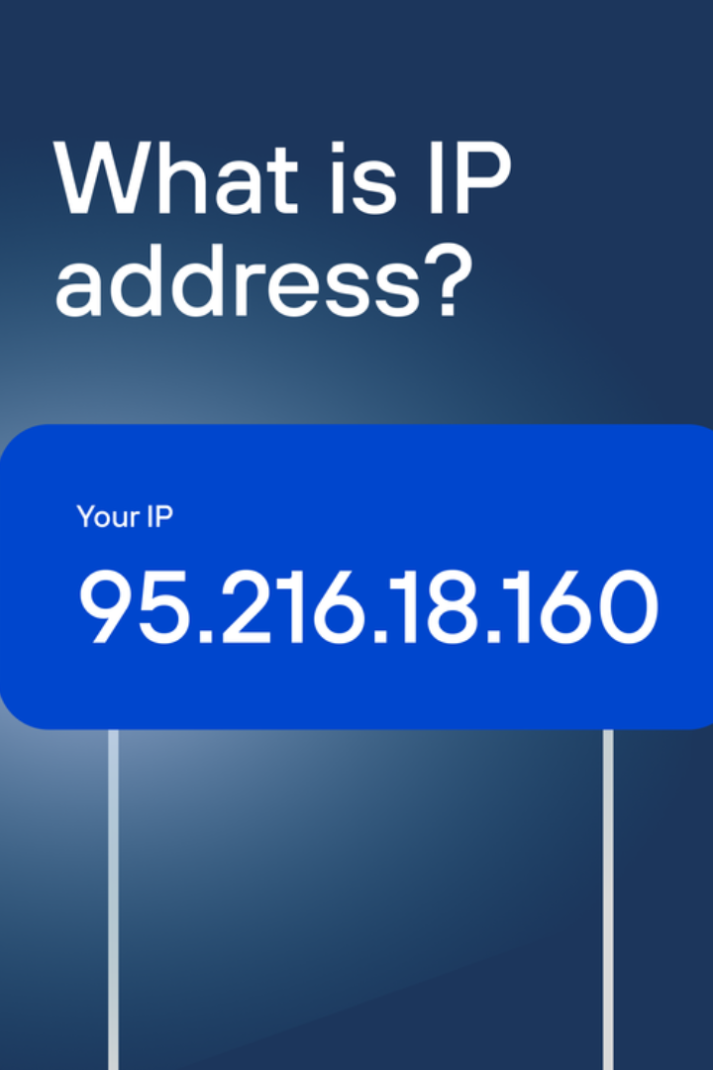
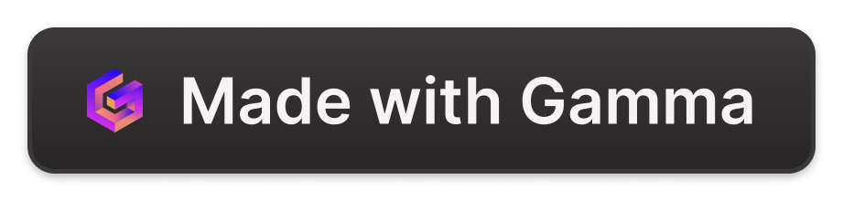
Introduction to IP Addresses
An IPv4 address is a 32-bit address that uniquely and universally defines the connection of a device (for example, a computer or a router) to the Internet. Two devices on the Internet can never have the same address at the same time.

Slide 2
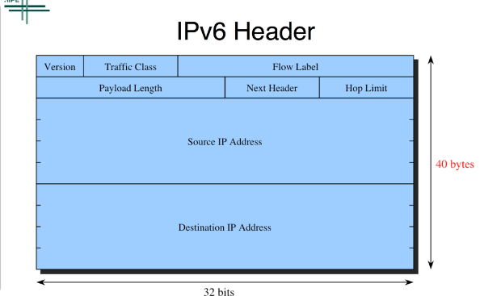
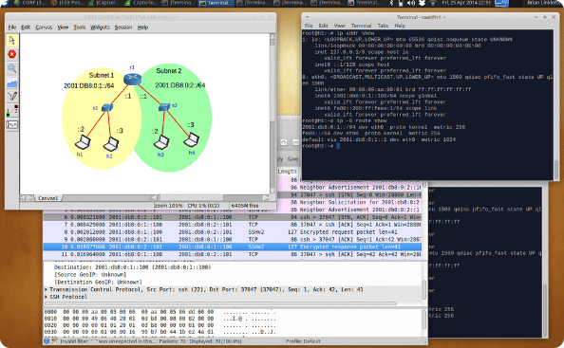
IPv4 vs IPv6
IPv4
IPv6
IPv4 is the fourth version of the Internet Protocol and uses a 32-bit address scheme. It is the most widely used IP protocol.
IPv6 is the latest version of the Internet Protocol and uses a 128-bit address scheme. It was developed to address the exhaustion of IPv4 addresses and provide additional features.

Slide 3
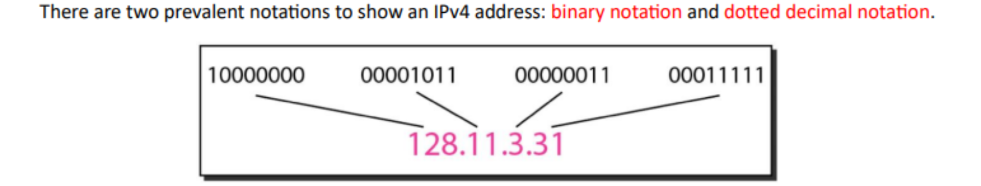
Binary Representation of IP Addresses
Decimal to Binary Conversion
Example
IP addresses are represented in binary format for efficient computer processing. Each decimal number in an IP address is converted to an 8-bit binary number.
For example, the decimal number 128 is represented as 10000000 in binary form.

Slide 4
Subnet Masks and CIDR Notation
1
Subnet Masks
2
CIDR Notation
A subnet mask is a 32-bit number used to divide an IP address into network and host portions. It is expressed in decimal form (e.g., 255.255.255.0).
CIDR (Classless Inter-Domain Routing) notation represents the subnet mask using a prefix length, such as /24, which denotes the number of network bits in the address.

Slide 5
what does the subnet calculator do ?? (our project)
The IP Subnet Calculator performs subnet calculations for the given network address block, subnet mask and determines the broadcast address, number of host and host range

